Slide 1

BAIS Capstone Project
Home Attendance for the Minnesota Twins
MLB Group
Beth Tiggelaar, Katie Zawoyski, Ryan Yuson, Sarah Phillips

Slide 2
Agenda
Challenge and Project Background
Objective
Methodology
Data Preparation
Data Understanding
Recommendations
Results and Findings

Slide 3
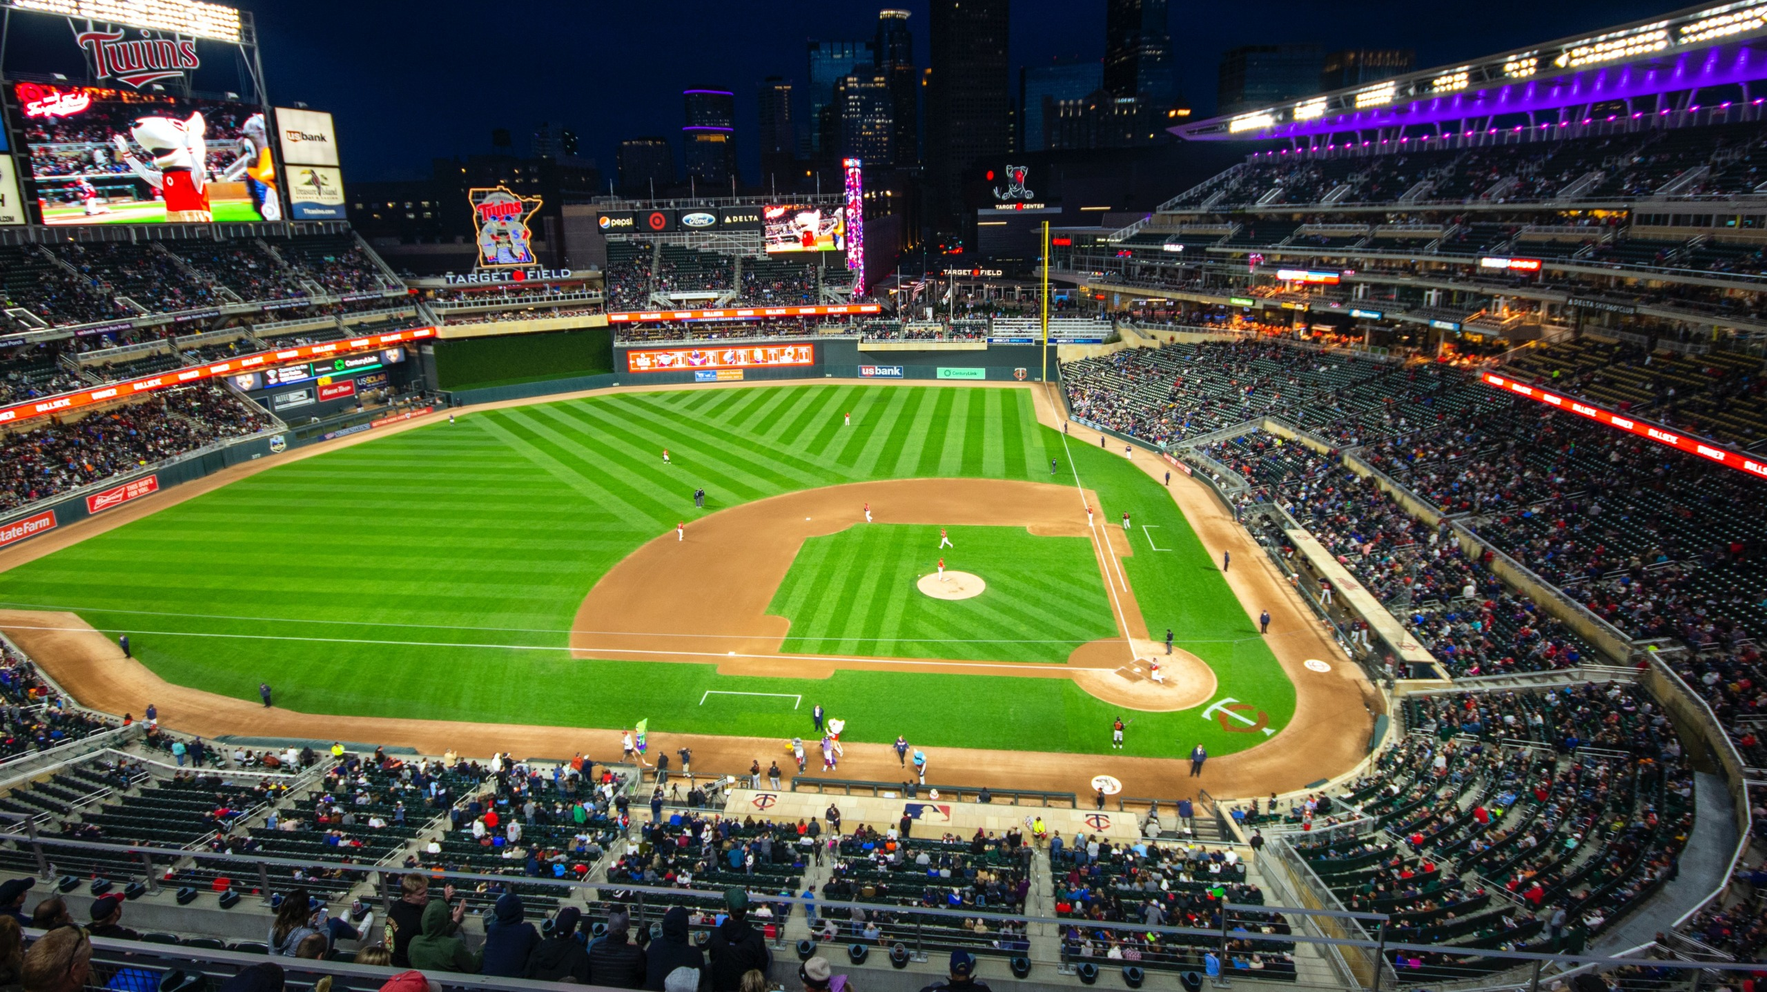
MINNeMUDac 2023 student data science Challenge
Host by MinneAnalytics
Client: Minnesota Twins / MLB

Slide 4
Understand mlb home game factors to inform attendance growth
Project Objectives:
Predict Twins Stadium Attendance
Identify key attendance factors
Strategy and Recommendations
Dynamic Model
Notes:
Build model predictive of home game attendance
Provide insight into what aspects of games influence attendance
Provide value to Twins in 3 key areas:
Operational Efficiency
Appropriate levels of ushers, gate staff, security
Proper concessions & merchandise inventory
Cost/capacity of processes (cleaning, restocking)
Sales and Revenue
Optimal pricing
Optimal promotion, discount, and event placement
understand
Business Financial Strategy
Ticket sale revenue, league-wide financial impact (revenue sharing)
Inform expense, payroll, capital investment budgets
General MPD strategies

Slide 5
Predicting Attendance for Business Process Optimization
Operational
Staffing Levels
Supply Chain Efficiency
Stadium Turnover
Notes:
Build model predictive of home game attendance
Provide insight into what aspects of games influence attendance
Provide value to Twins in 3 key areas:
Operational Efficiency
Appropriate levels of ushers, gate staff, security
Proper concessions & merchandise inventory
Cost/capacity of processes (cleaning, restocking)
Sales and Revenue
Optimal pricing
Optimal promotion, discount, and event placement
understand
Business Financial Strategy
Ticket sale revenue, league-wide financial impact (revenue sharing)
Inform expense, payroll, capital investment budgets
General MPD strategies

Slide 6
Predicting Attendance for Business Process Optimization
Operational
Staffing Levels
Supply Chain Efficiency
Revenue
Dynamic Pricing
Stadium Turnover
Sales Performance Metrics
Promotions & Events
Notes:
Build model predictive of home game attendance
Provide insight into what aspects of games influence attendance
Provide value to Twins in 3 key areas:
Operational Efficiency
Appropriate levels of ushers, gate staff, security
Proper concessions & merchandise inventory
Cost/capacity of processes (cleaning, restocking)
Sales and Revenue
Optimal pricing
Optimal promotion, discount, and event placement
understand
Business Financial Strategy
Ticket sale revenue, league-wide financial impact (revenue sharing)
Inform expense, payroll, capital investment budgets
General MPD strategies

Slide 7
Predicting Attendance for Business Process Optimization
Operational
Staffing Levels
Supply Chain Efficiency
Revenue
Dynamic Pricing
Strategic
Stadium Turnover
Informed Budgeting
Marketing & Product Development
Revenue Forecasting
Sales Performance Metrics
Promotions & Events
Notes:
Build model predictive of home game attendance
Provide insight into what aspects of games influence attendance
Provide value to Twins in 3 key areas:
Operational Efficiency
Appropriate levels of ushers, gate staff, security
Proper concessions & merchandise inventory
Cost/capacity of processes (cleaning, restocking)
Sales and Revenue
Optimal pricing
Optimal promotion, discount, and event placement
understand
Business Financial Strategy
Ticket sale revenue, league-wide financial impact (revenue sharing)
Inform expense, payroll, capital investment budgets
General MPD strategies

Slide 8
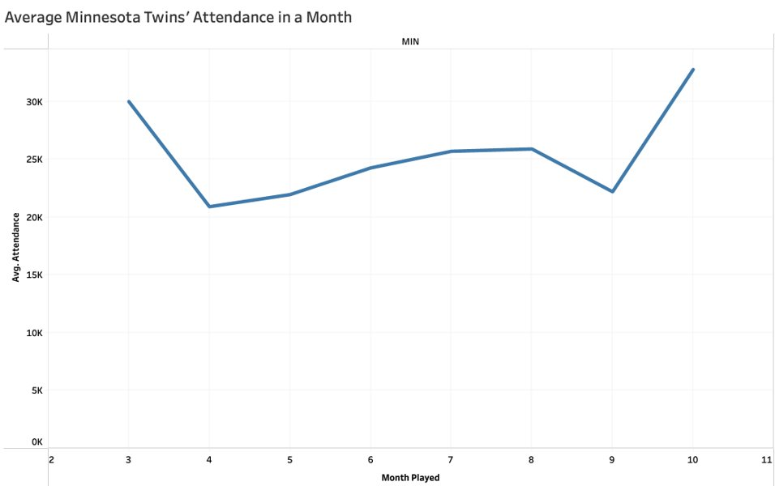
Data insights to Improve Dips in Attendance

Slide 9
Methodology
T-test and Variable Importance

Slide 10
Methodology
T-test and Variable Importance
Initial regression model

Slide 11
Methodology
T-test and variable importance
Initial regression model
External data

Slide 12
Methodology
T-test and Variable Importance
Initial Regression Model
Collect External Data
Integrate into Final Regression

Slide 13
Data Preparation
Properly format data types
1
Create dummy variables from categoric features
2
Handle column position for consistency
3
Remove instances with invalid attendance
4
Create subsets from GameLogs
6
Gather and integrate external data
5
Notes:
1.
2.
3.
4. Null/negative attendance
5. R and excel
6. Train and test data

Slide 14
Areas of Data Exploration
Minnesota Twin’s Average Attendance
MLB Attendance Time Comparisons
League Attendance Comparisons
Variable Importance
Attendance by Location

Slide 15
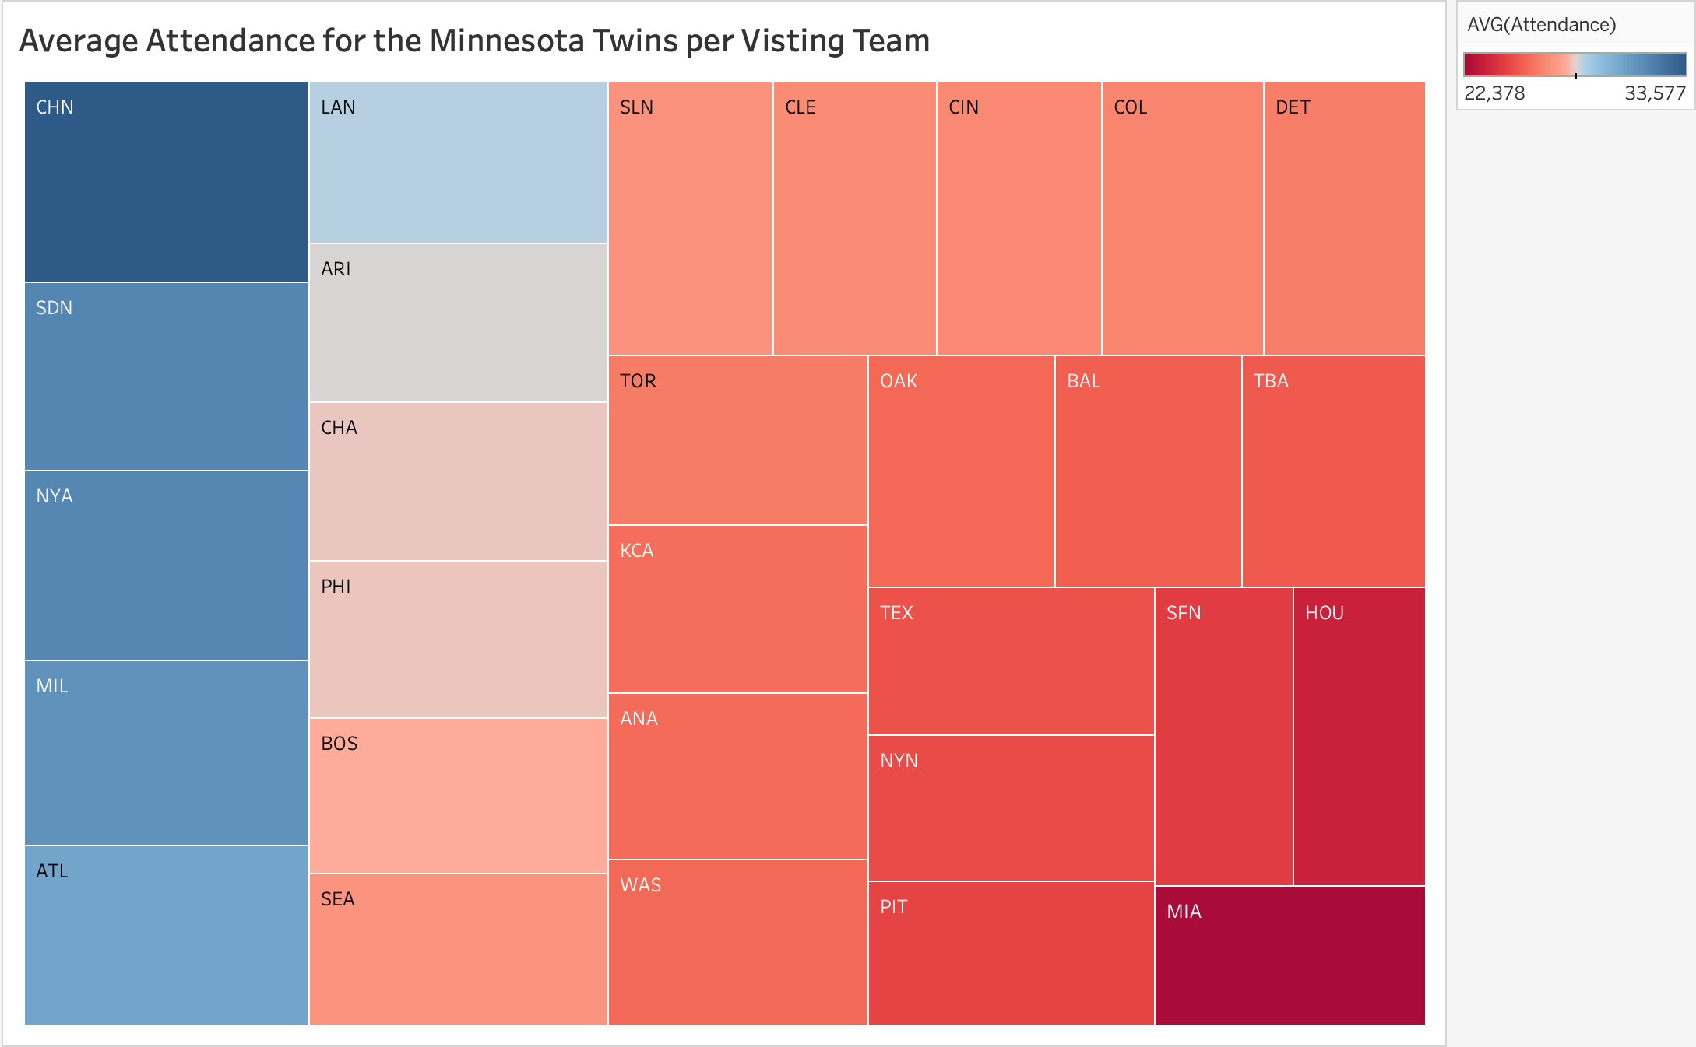
Minnesota Twins Attendance Compared to Visiting Team Attendance
Chicago Cubs have the highest attended games on average
Miami Marlins have the lowest attended games on average

Slide 16
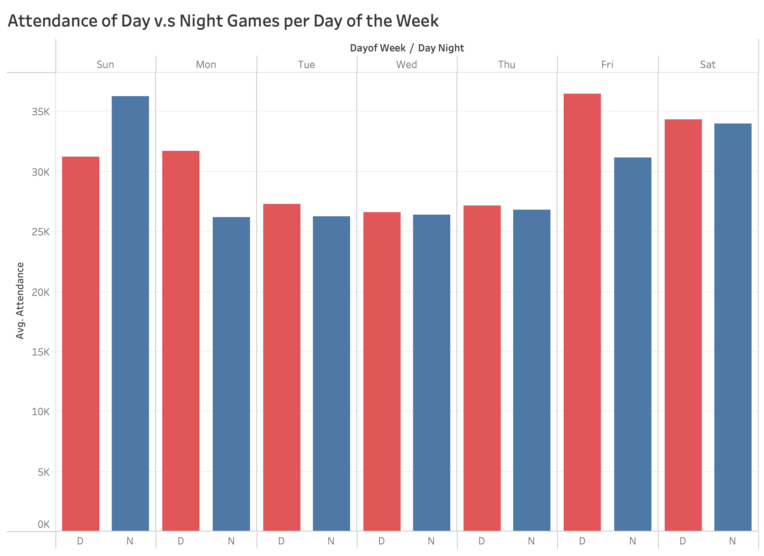
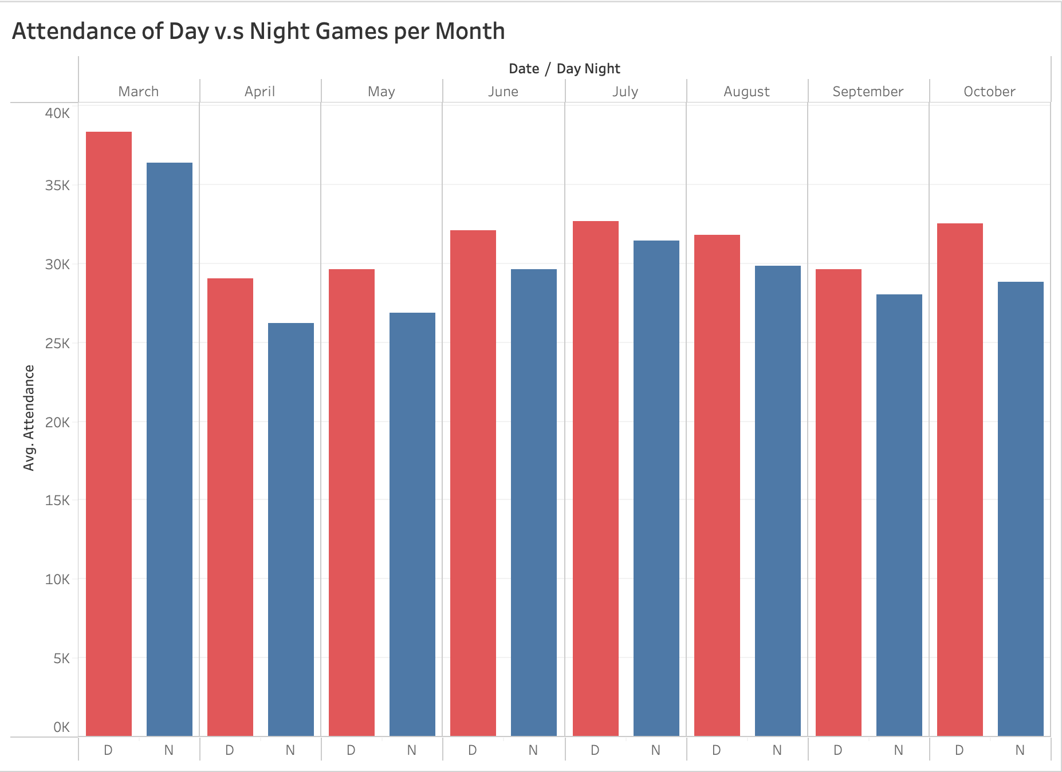
Day Games Average Higher Attendance Throughout MLB

Slide 17
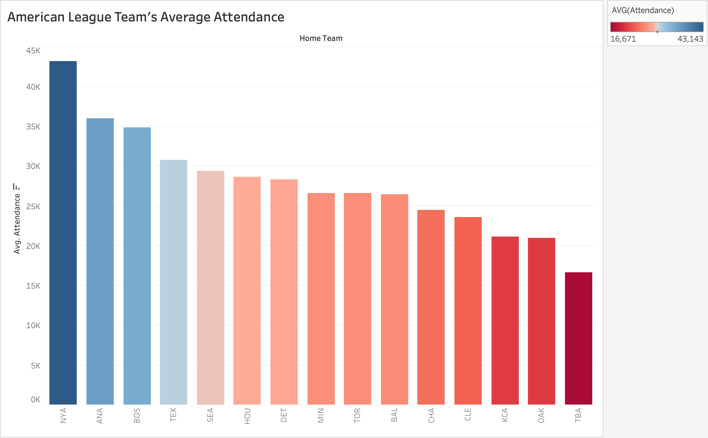
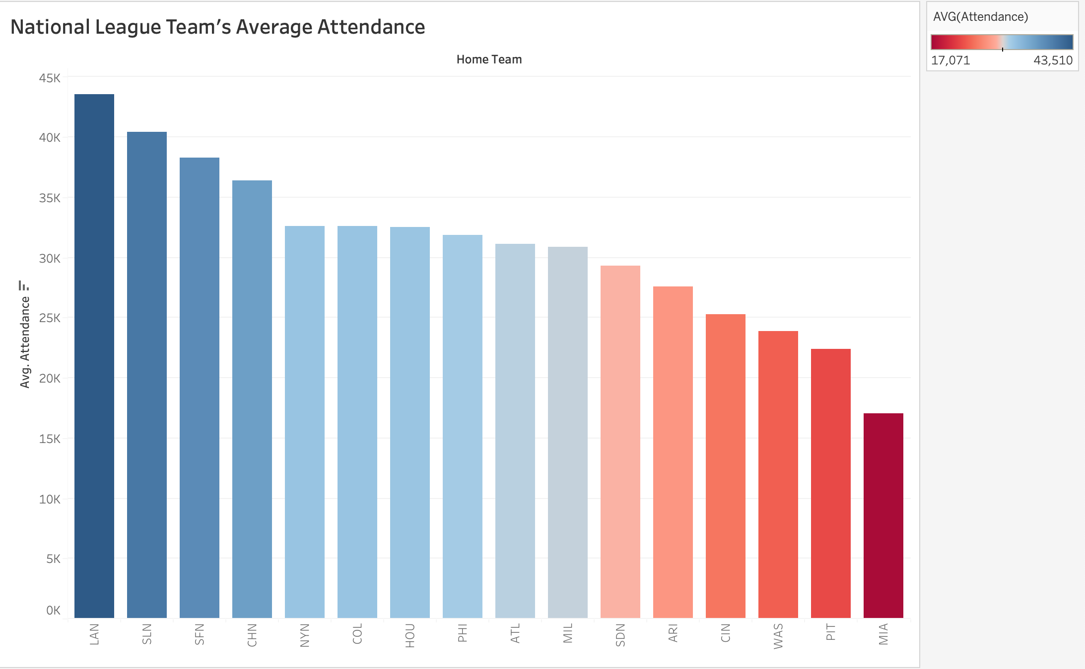
Attendance variance by league

Slide 18
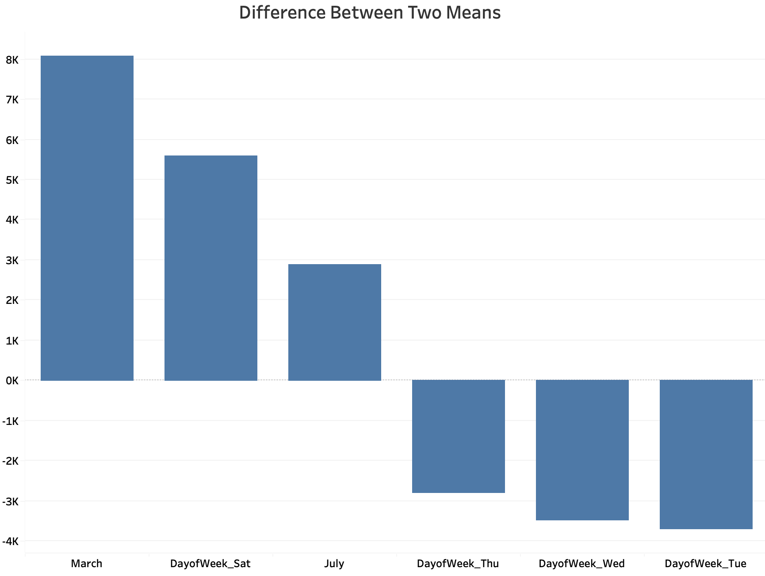
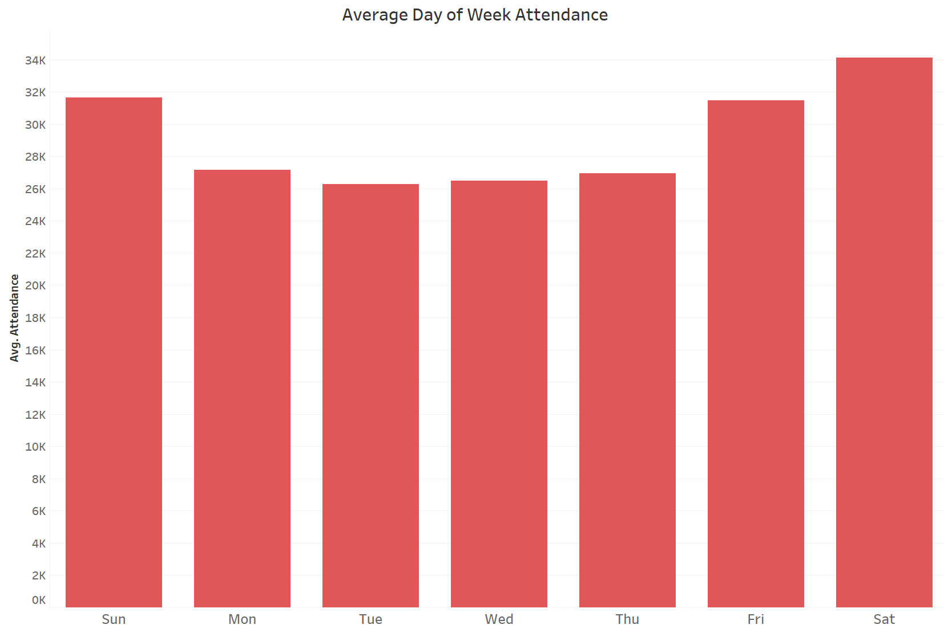
Variable Importance provides Data Insights
March, July, and Saturday games have a positive impact on attendance
Weekdays average the lowest Attendance

Slide 19
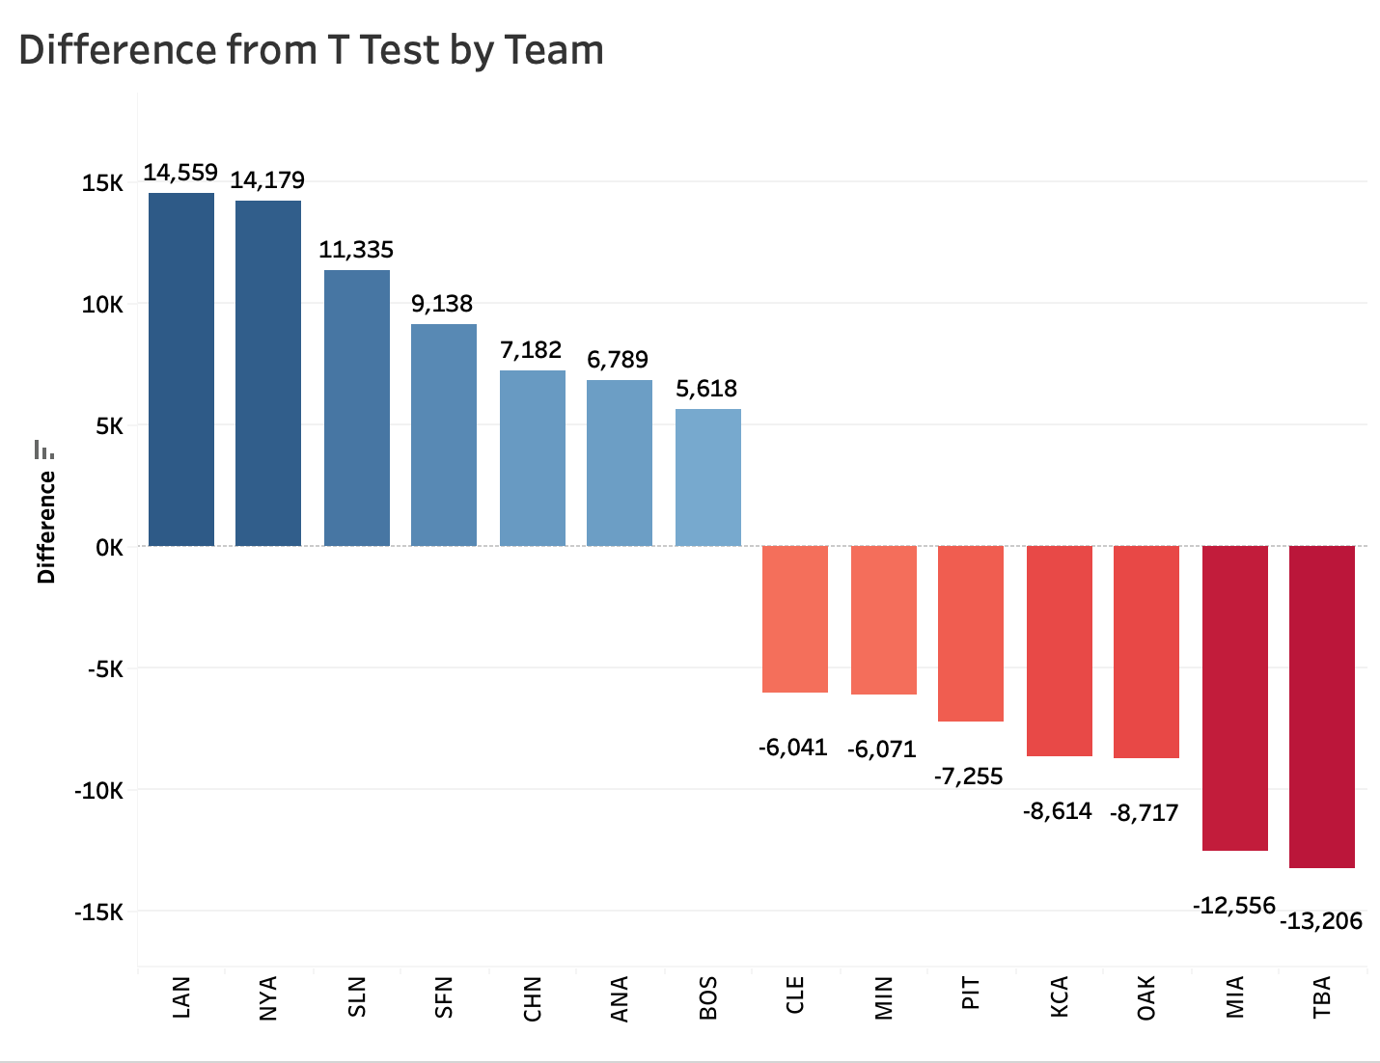
Highly impactful teams help inform business strategy
Los Angeles Dodgers, New York Yankees, and St. Louis Cardinals have largest positive impact on attendance

Slide 20
external data provides a holistic approach to stadium insights
Modeling
Capacity
City Population
Exploration
League Affiliation
Professional Teams
Stadium Location
Team Promotions
Previous Attendance
Season
Cost to Attend
Notes:
External Data Collected Used in Model:
External Data Collected For General Analysis:

Slide 21
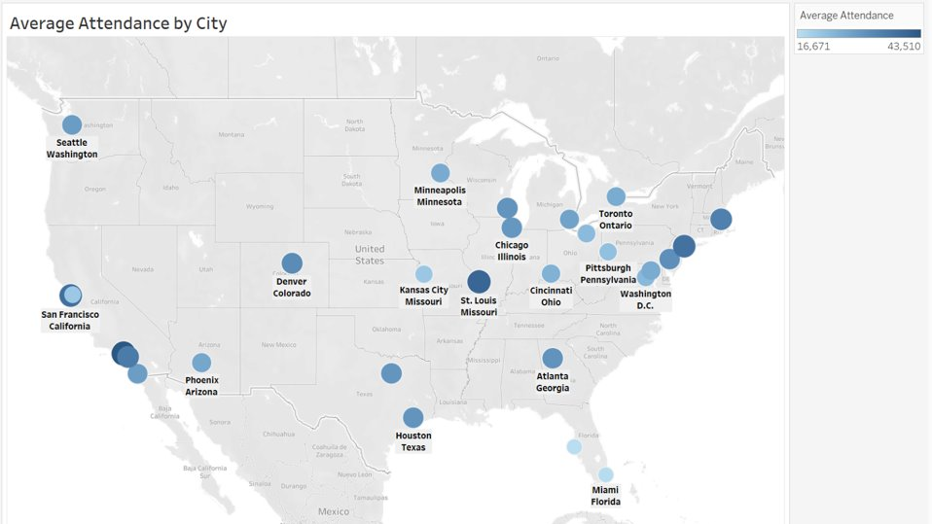
Stadium Location Affects average attendance
Los Angeles, CA and St. Louis, MO have the highest average attendance
St. Petersburg, FL and Miami, FL have the lowest average attendance followed by Oakland, CA

Slide 22
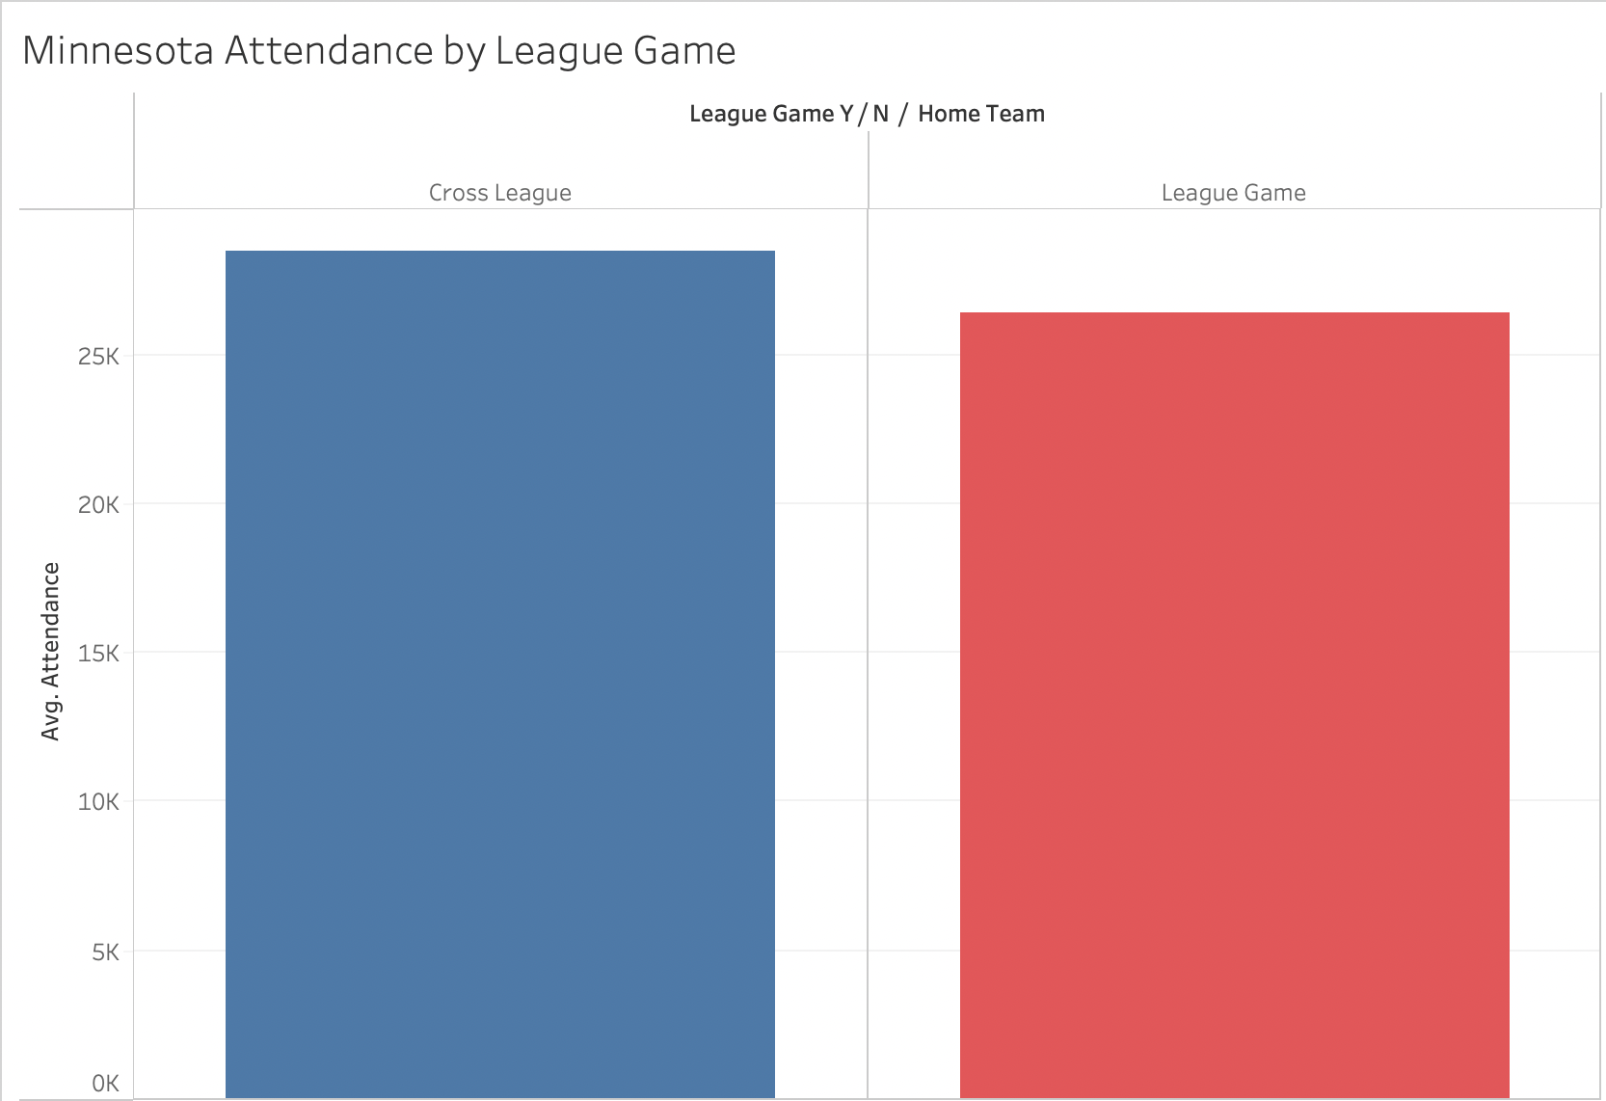
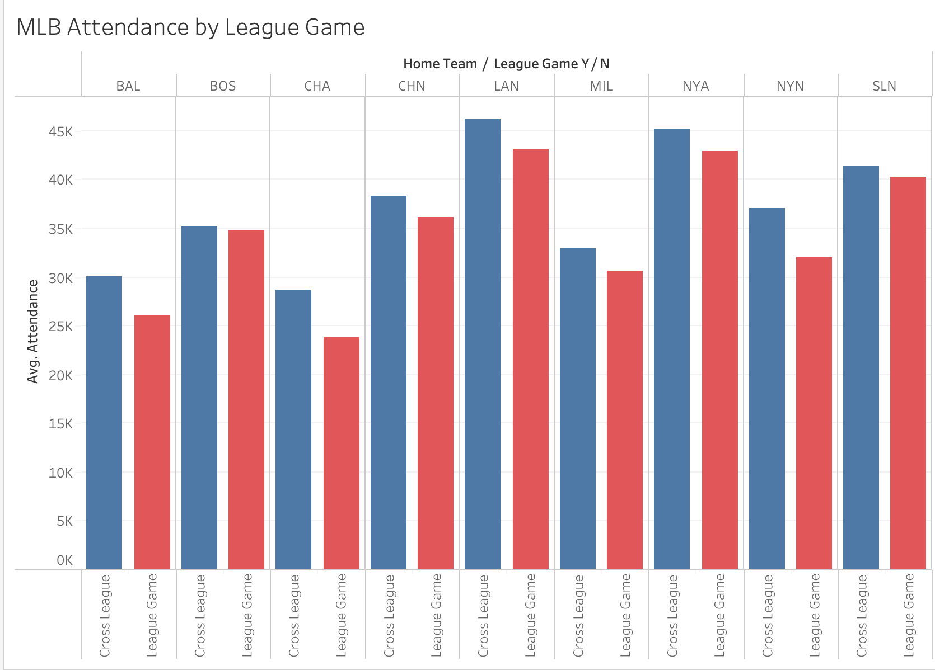
Cross League Game Averages higher Attendance Rates
Minnesota Average Attendance by League
Other MLB Average Attendance by League

Slide 23
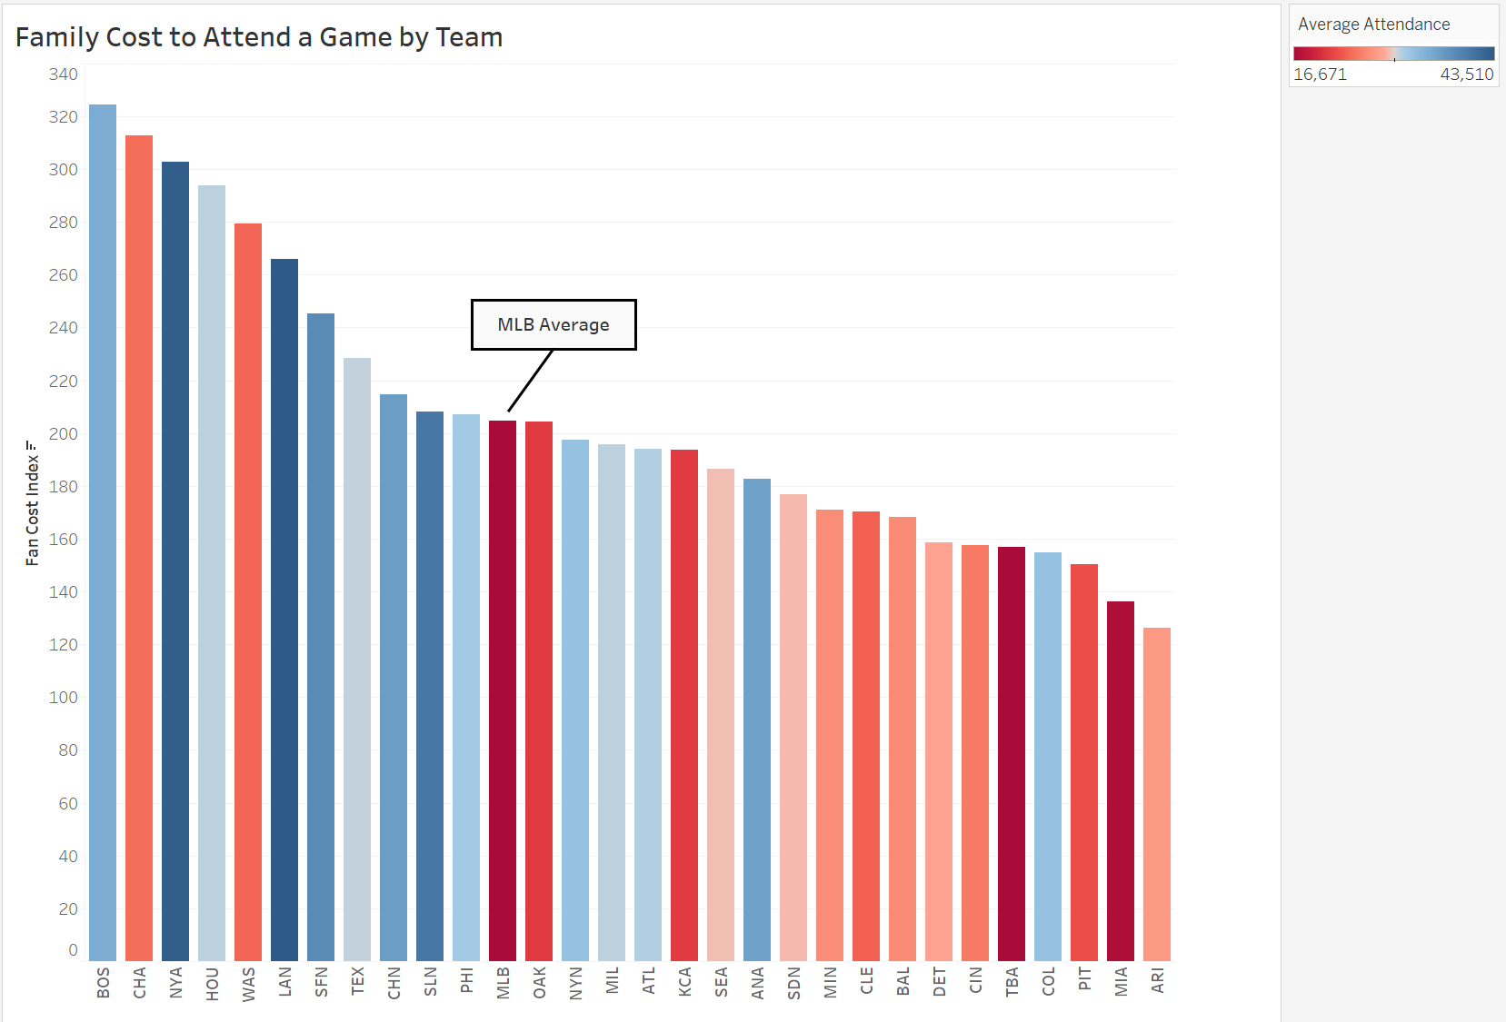
Cost to attend a game varies by team and city

Slide 24
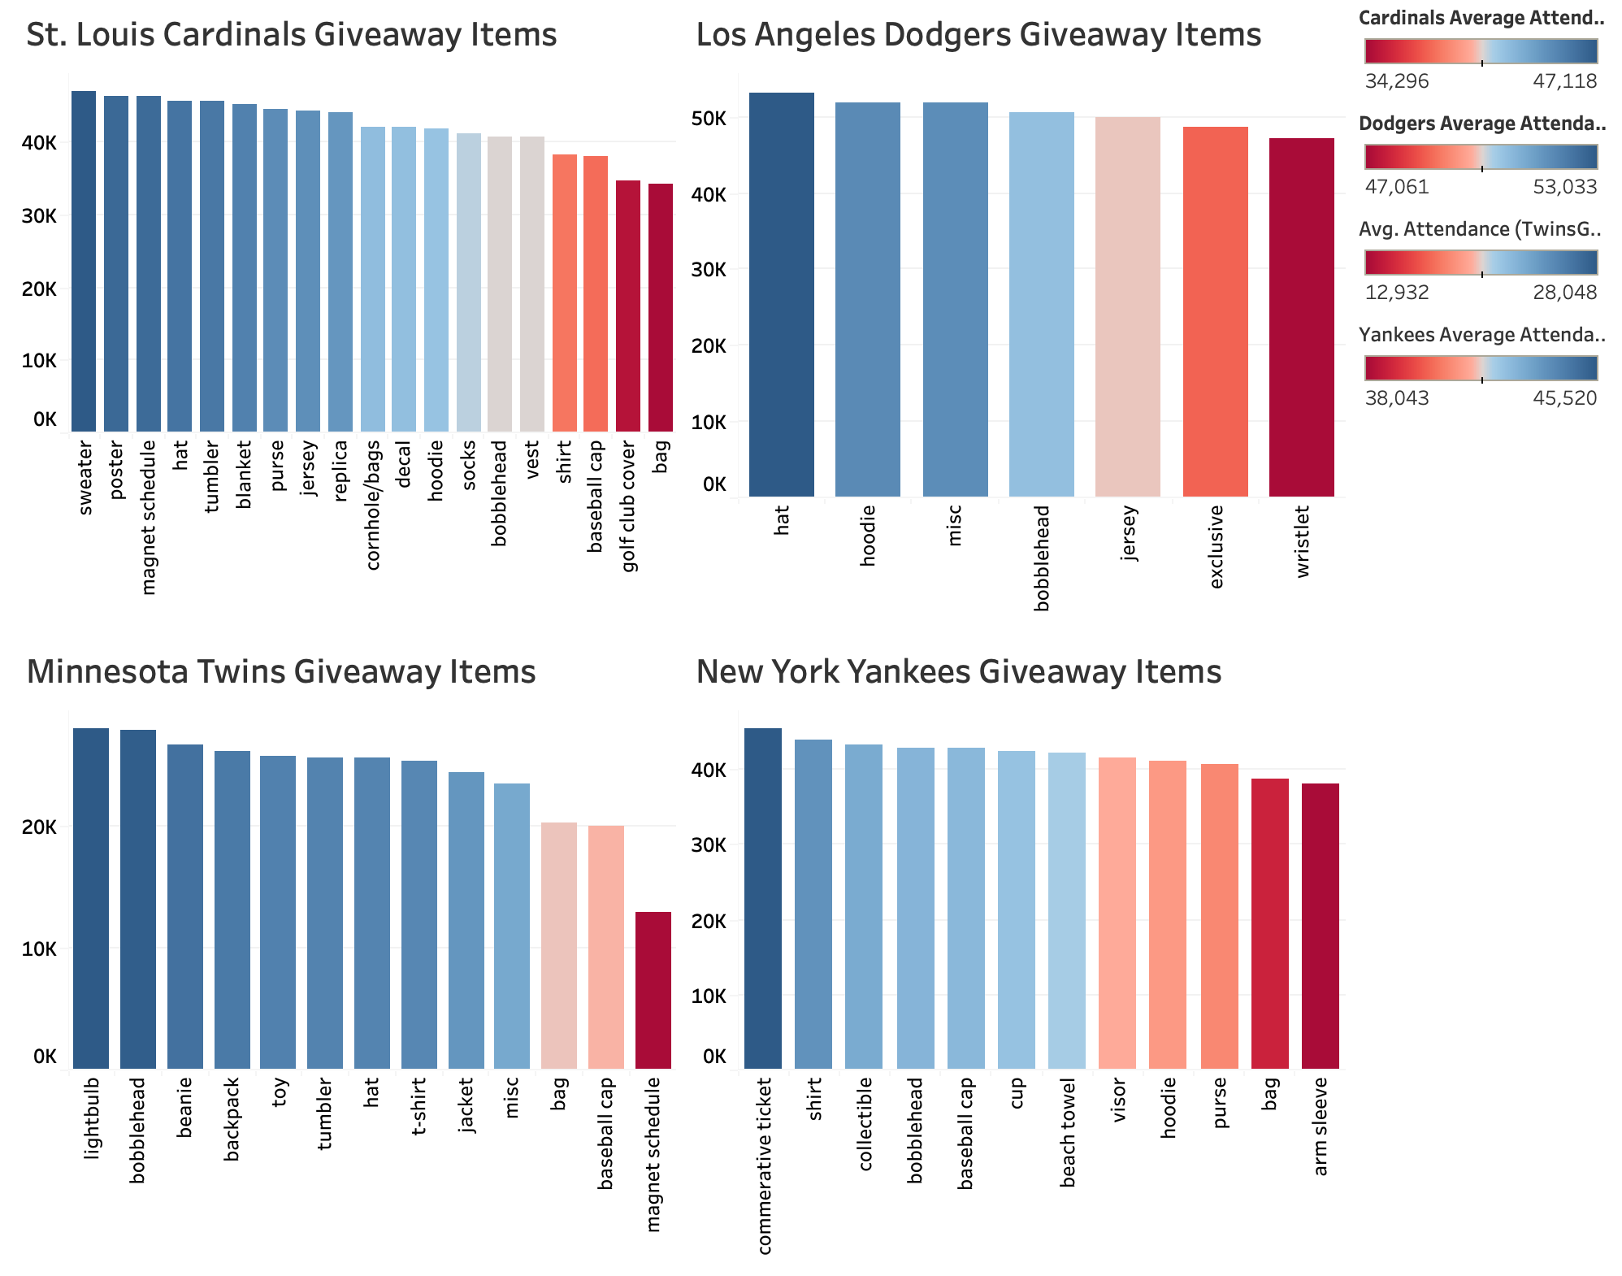
League wide promotional trends
St. Louis Cardinals
Personal clothing items, bundled items, adult 16+ items average higher attendance
Los Angeles Dodgers
Bobbleheads highest count/account for most sum of attendance
New York Yankees
Commemorative/collectible items draw attendance for special occasions
Notes:
Clothing items
Complement exclusive events with free item giveaways
Frame more items as exclusive/collectible
commemorative/collectible items
(ticket, replica statues, plaques)
RYAN

Slide 25
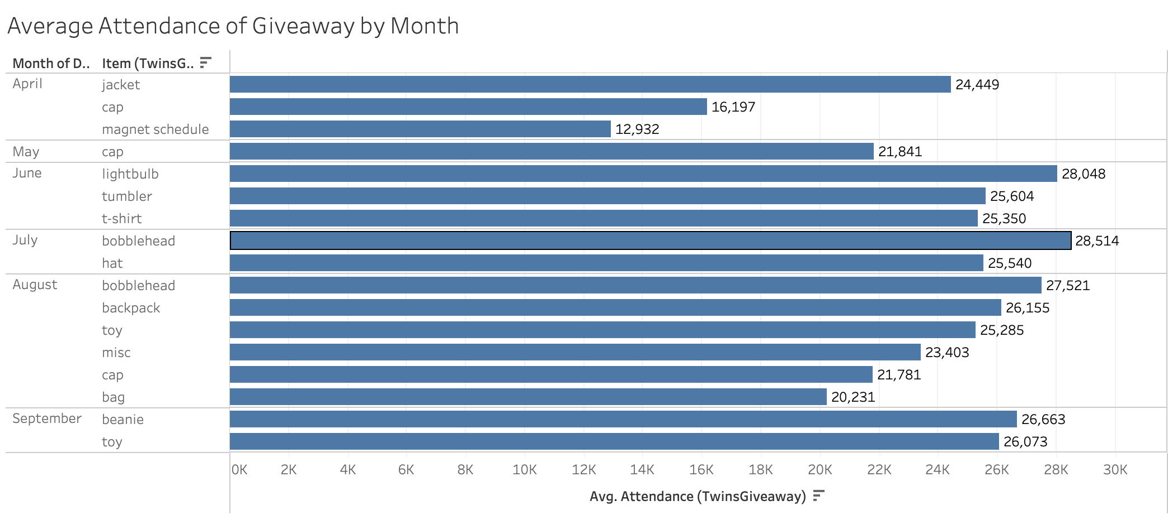
Twins Promotional Insights
Giveaways are heavily saturated in summer months
Increase Spring/early Summer giveaway opportunities
Bobbleheads are utilized ineffectively
Increase bobblehead variety and giveaway opportunities
Child-specific giveaways observe higher attendance
Explore and offer more family-oriented promotions
Notes:
Even out distribution of giveaways throughout the season
Fans love free stuff

Slide 26
Project Recommendations
April, May, September
Revise giveaway schedule
Season Opener/Closer
Monthly Ticket Bundles
Area of Weakness:
Promotional Recommendations:

Slide 27
Project Recommendations
April, May, September
Season Opener/Closer
Expand concession deals
Local partnerships
Corporate events
Family oriented 'summer night' promotions/events
Tuesday, Wednesday, Thursday
Revise giveaway schedule
Monthly Ticket Bundles
Area of Weakness:
Promotional Recommendations:

Slide 28
Project Recommendations
Spring Games
Discounted Season Ticket Bundles
Early season promotions
Area of Weakness:
Improvement:

Slide 29
Project Recommendations
Spring Games
Discounted Season Tickets
League games
Themed games
Giveaways
Promote rivalries
Early season promotions
Area of Weakness:
Improvement:

Slide 30
Project Recommendations
Area of Weakness:
Improvement:
Spring Games
Discounted Season Tickets
League games
Themed games
Cost of attending Games
Food/beverage tickets, dinner package
Concession discounts
Giveaways
Promote rivalries
Early season promotions

Slide 31
Utilizing Regression Models to Predict 2023 MLB stadium attendance
Eight regression tests ran
Trained on 20 years of data, tested on the 2022 season
Evaluated on Mean Absolute Error
Random Forest – All predictors without Cross Validation had the strongest results
Data Set | Model Approach | Train MAE | Test MAE | Difference
Original Data | RF - All predictors wo CV | 1951.817 | 2041.051 | 89.234
External Data | RF - All predictors wo CV | 1871.633 | 2239.578 | 367.945
External Data with Previous Attendance | RF - All predictors wo CV | 1579.74 | 1384.599 | -195.141

Slide 32
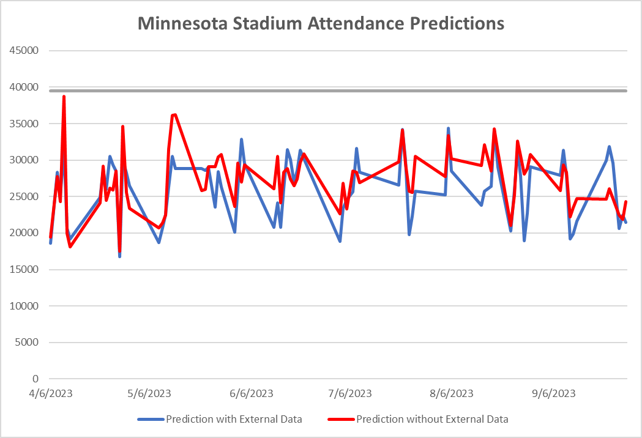
Stadium Prediction Results
Target Field Capacity Level

Slide 33
Twins ATTENDANCE Model Results from played games
*4/9 was Easter – not noted in model

Slide 34
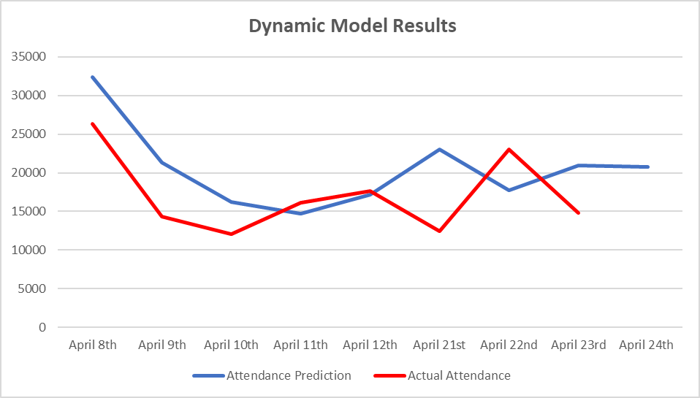
The dynamic model produces the most accurate results

Slide 35
Outcomes and Student Takeaways
Communication is the key factor to team success

Slide 36
Outcomes and Student Takeaways
Communication is the key factor to team success
Being thorough when going through original data is crucial

Slide 37
Outcomes and Student Takeaways
Communication is the key factor to team success
Being thorough when going through original data is crucial
Setting a standard meeting time leads to higher quality of work
Notes:
Longer meeting times vs shorter

Slide 38
Appendix
https://www.google.com/url?sa=i&url=https%3A%2F%2Fwww.mlb.com%2Fnews%2Ftwins-announce-upcoming-brand-refresh-staff-promotions&psig=AOvVaw1AaDZNB-akK-Kl5PSHVpzj&ust=1682004594179000&source=images&cd=vfe&ved=0CBAQjRxqFwoTCMD30MShtv4CFQAAAAAdAAAAABAR
https://parkmobile.io/blog/target-field-ball-game/

